Slide 1
Semantic Retrieval of ICS Security Requirements from BSI and NIST Standards
Dipan Banerjee
Notes:
1

Slide 2
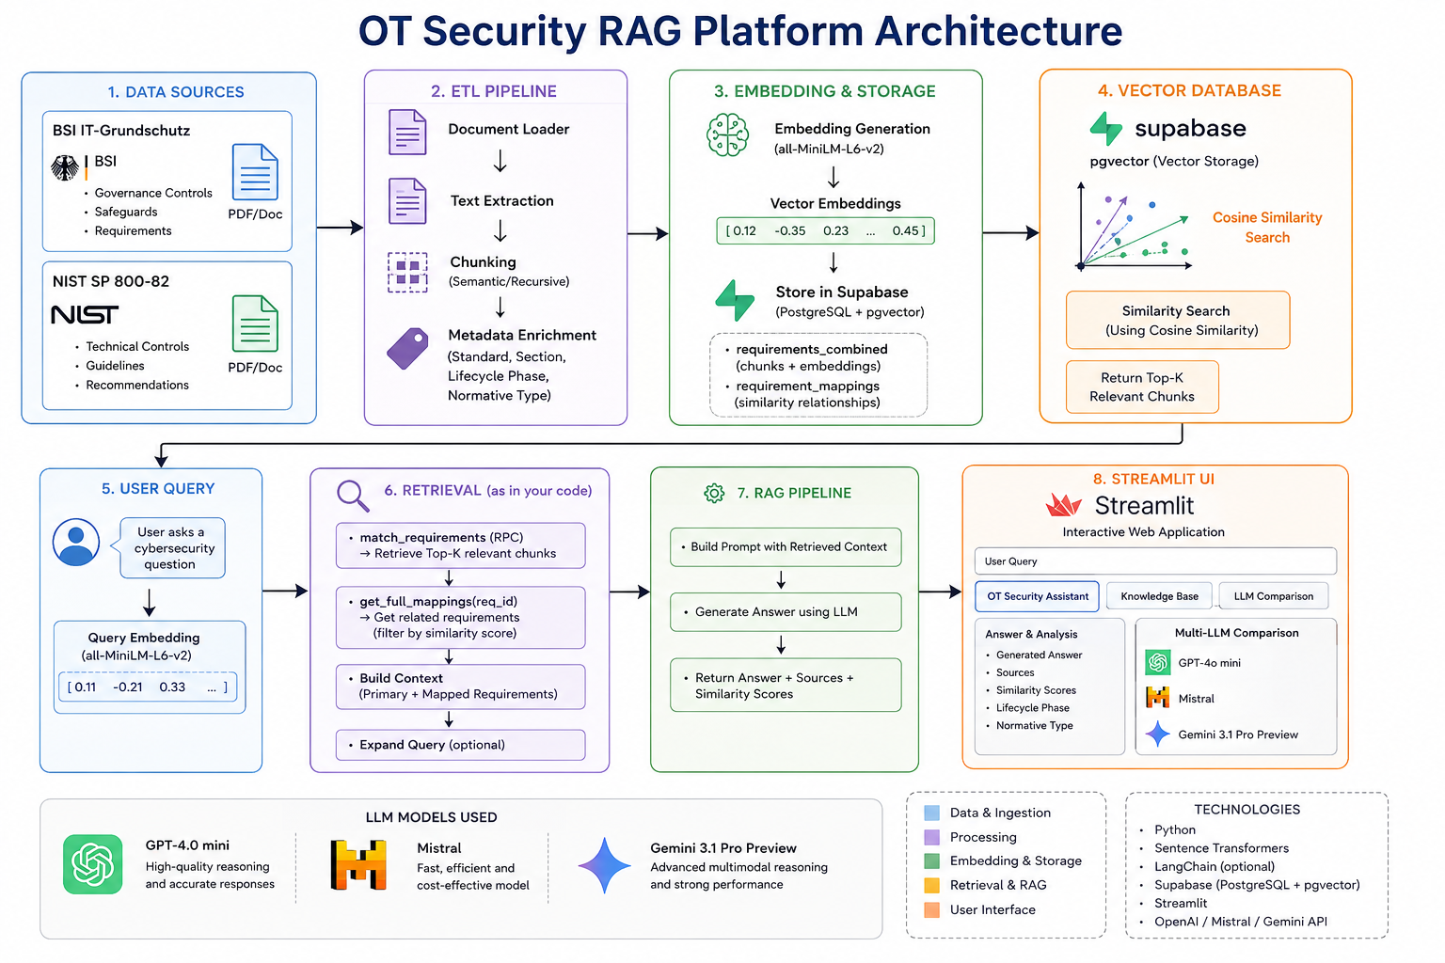
Recap
2
Notes:
2

Slide 3
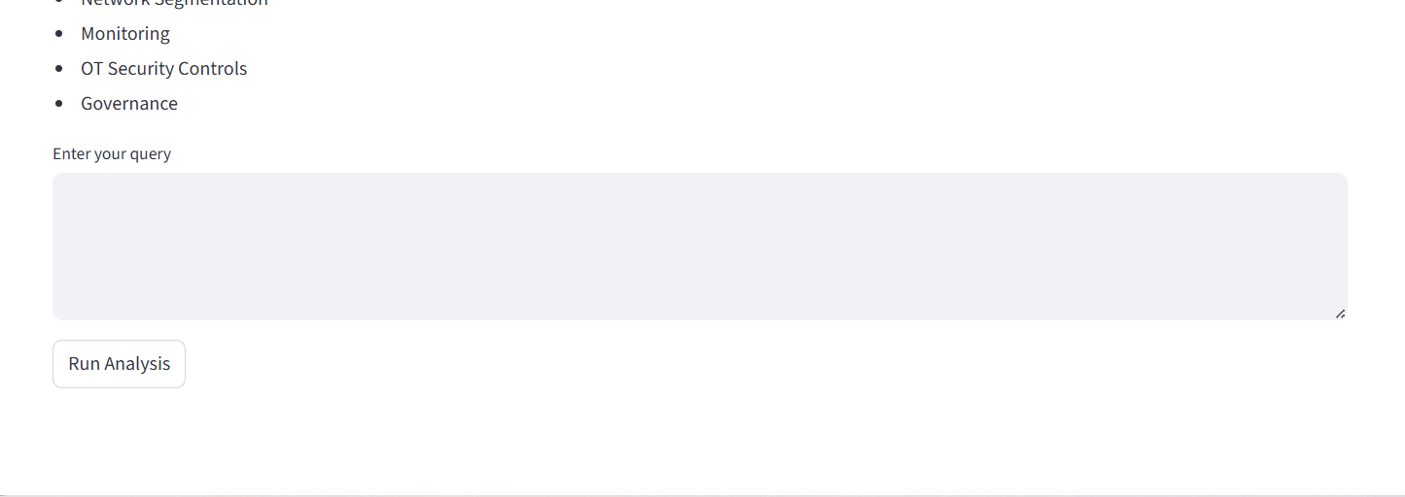
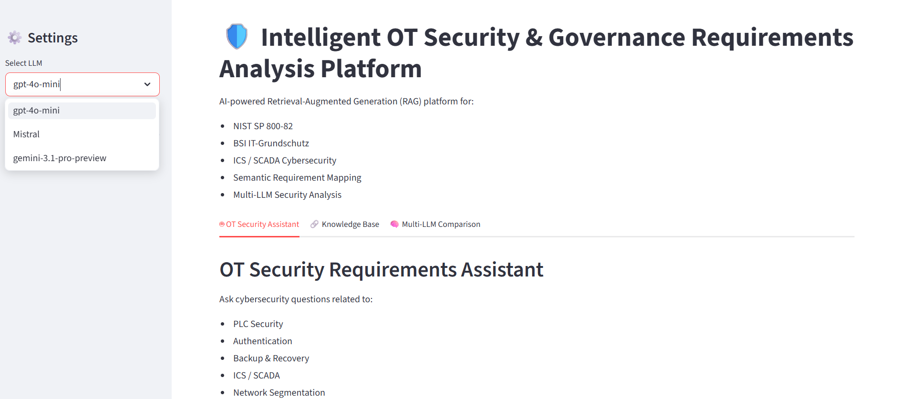
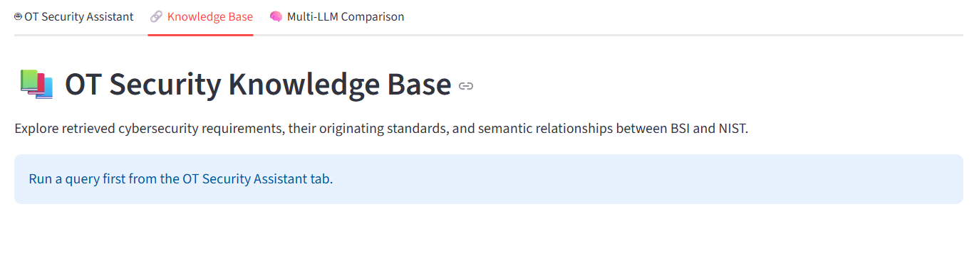
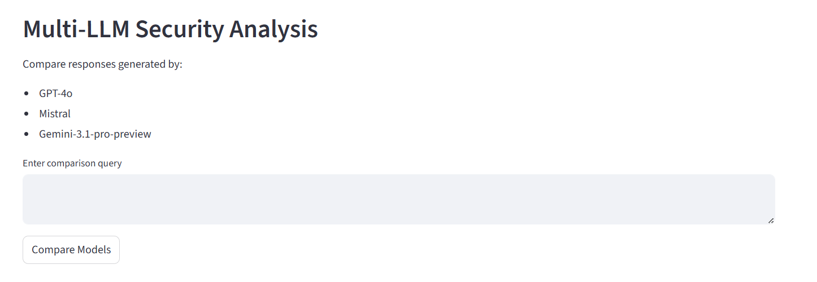
Streamlit App
3
Notes:
3

Slide 4
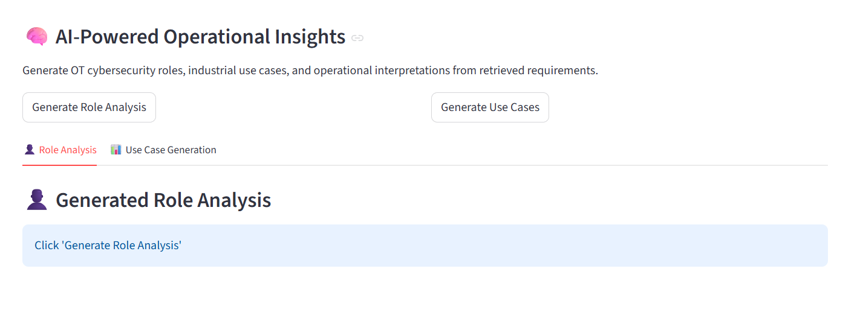
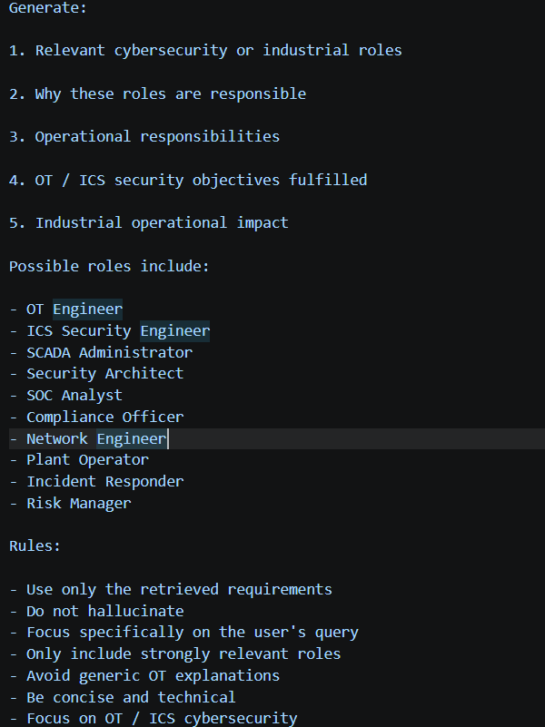
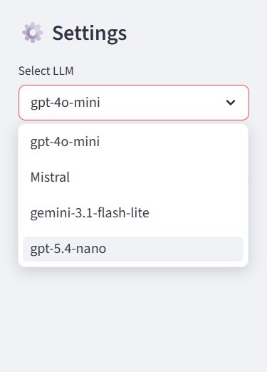
Improvement
4
Notes:
4

Slide 5
Task for Human Evaluation
To calculate:
Precision@K
Recall@K
MRR
Similarity relevance
Multi-LLM comparison
Students will be given some queries.
Regarding every aspect like PLC, OT, Governance etc.
Students will check the generated output and compare it with multi LLM models.
Run the queries and see knowledge base to check whether it make sense or not.
Also check the similarity score to check and verify.
Google Form will be given with the necessary questions.

Slide 6
Topics of Discussion
6
How will the students know about which role does the query gives in order to check for them?
How many queries will be suitable for my thesis?
Notes:
6

Slide 7
7
Thank you
Notes:
7

